Slide 1
Where Genomics Meets Big Data
Sharon Barr, CTO
Greg Gibeling, MS, Architect
Tina Duccini, Talent Acquisition
Hannah Thompson, Talent Acquisition

Slide 2
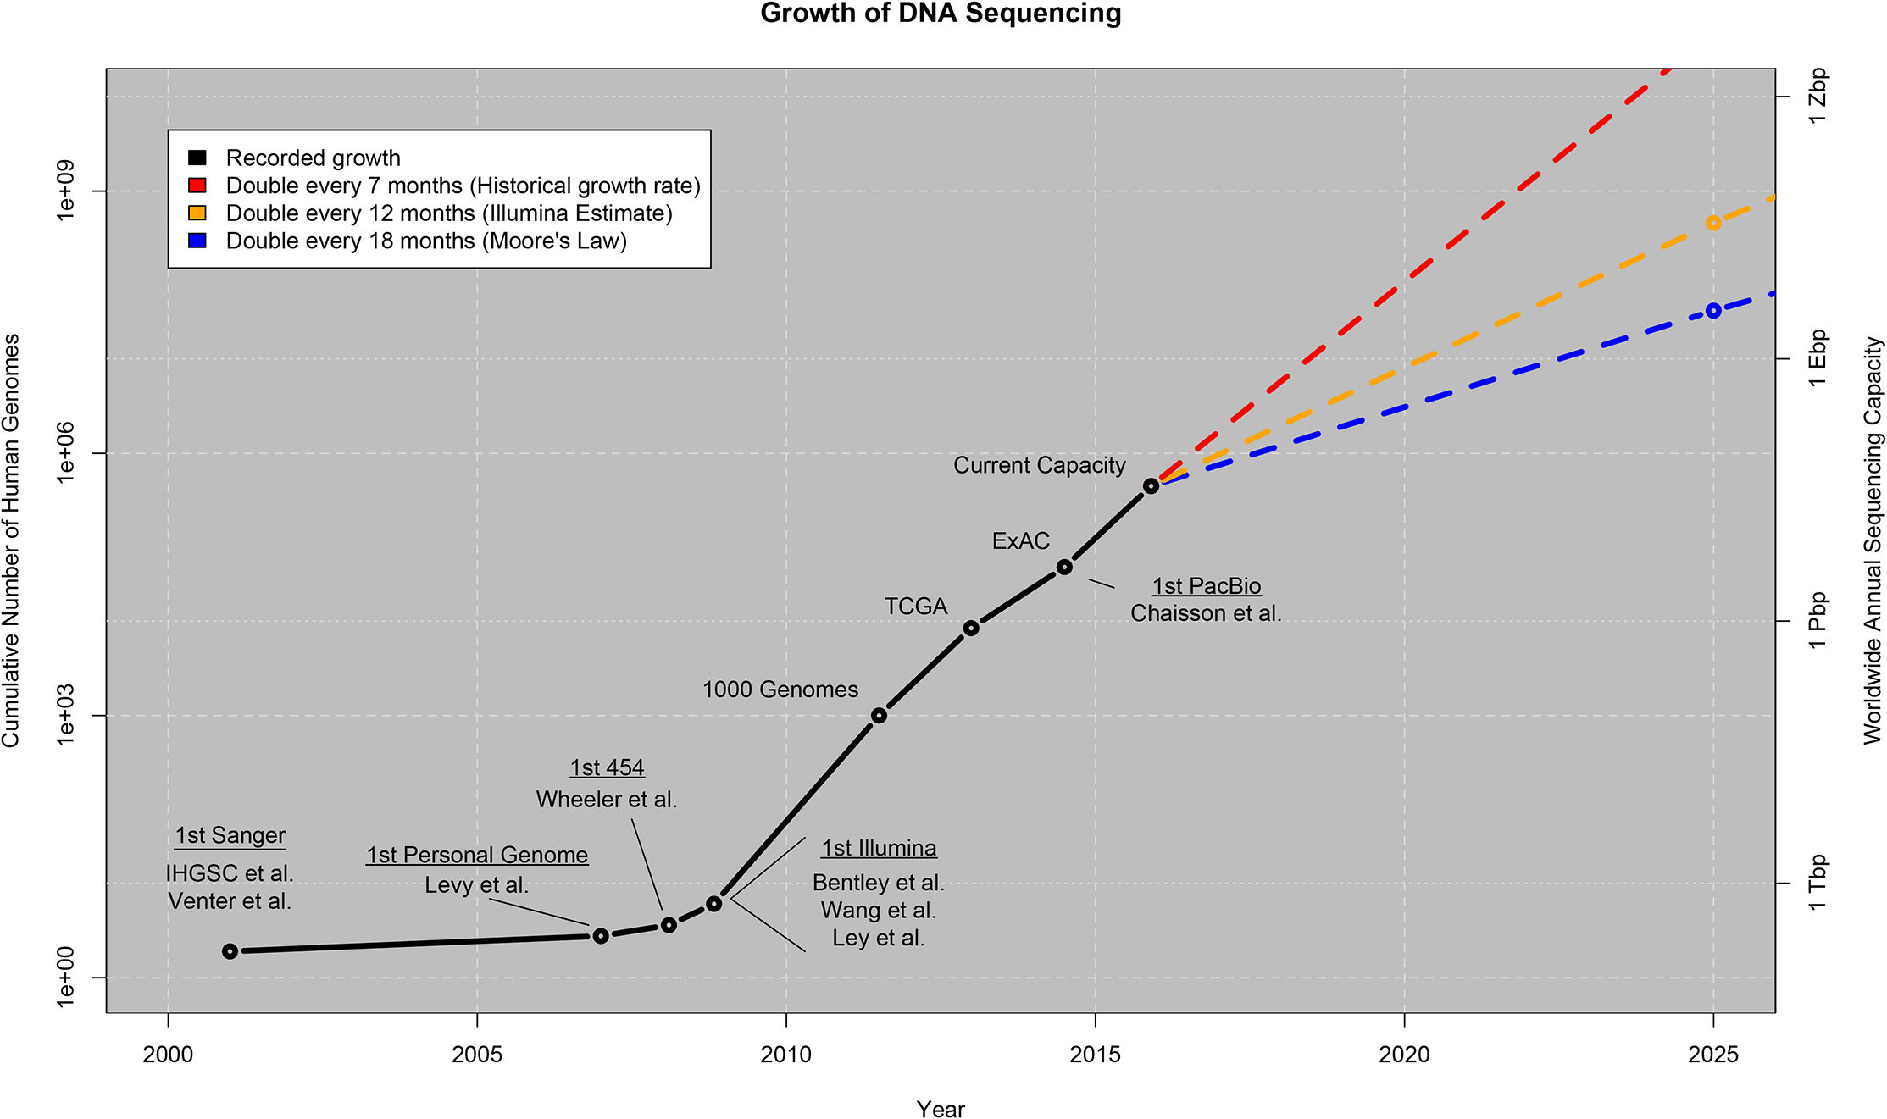

Exponential Growth of DNA Sequencing Data
Stephens ZD, Lee SY, Faghri F, Campbell RH, Zhai C, et al. (2015) Big Data: Astronomical or Genomical?. PLoS Biol 13(7): e1002195. doi:10.1371/journal.pbio.1002195
http://journals.plos.org/plosbiology/article?id=10.1371/journal.pbio.1002195
Notes:
To put the enormity and magnitude of data challenges in perspective, I want to share a research that was recently published by researchers in university of illinois at Urbana champagne.
According to this research the volume of genomic datasets in the world will soon exceed the collected data of YouTube, Twitter, and Astronomy : the largest major sources of Big Data in our era. Suggesting the phrase astronomical will be replaced by “genomical”
2025 zetta base billion thrillion bases
In addition to the volume of these datasets, the dynamic nature of science of interpretation, the unique distribution model, the regulatory and compliant medical environment makes the problem even more challenging.
Unique:
Scientific analysisc
Data privacy
Data volume upload and distribution

Slide 3
How Data and Technology will Transform Medicine?
Research & Discovery
Clinical Development
Companion Diagnostics
Biomarker Identification & Validation
Target Discovery & Genomic Characterization
Expression Analysis
Drug Resistance Pathways
Disease Mechanism of Action (MOA) and Pathway Prediction
Pharmacogenomic Safety & Efficacy Assessments
Characterization of Genetic Variation in Clinical Trial Cohorts
Population Studies
Patient Stratification
Identify Drug Resistant Clinical Cohorts
Pharmacogenomics
Genotoxicity & Adverse Reaction Prediction
NGS-Based Companion Diagnostics
Personalized Therapy Strategies
Therapy Selection
Predicting Drug Resistance
Drug Repositioning
Notes:
NGS opportunity .
Challenges : volume, dynamic. …
Transforming many aspects of research and medicine at every single point
The consequences of new technology : organizations work together, linear or systematic digestion of data.
We have an opportunity in front of us. For the last decades the scientists and technologists were working on developing technologies for observing and measuring biology in depth and details. Now thanks to revolutionary progress in technologies such as Next Generation Sequencing our generation is capable to have visibility to the origins of health and disease at unprecedented depth, scale, and details. The cost of sequencing a human genome has dropped million folds over the last decade. However there is a long way to go to transform this data to actual knowledge and transform the practice of medicine. Our generation is witnessing the inflection point where the cost and challenge of analysis and interpretation of these datasets become much greater than producing them.
Technologies such as Next Generation Sequencing, liquid biopsies, Wearable health-care devices and sensors, are drivers of the future of medicine.
These technologies provide massive, dynamic, and versatile sources of data that helps us decipher the mysteries of complex diseases such as cancer.
Ultimately they make the future of preventive, predictive, targeted, and precision medicine possible.
However, leveraging this data requires a transformation in how we do research in discovering new biomarkers or drugs, and transform how we practice medicine.
The complexity, volume, and dynamic nature of NGS datasets requires new approach to data management, sharing, processing and integration that is new even to the most advanced research centers in the country.
At Bina we are determined to face this challenge. We are informatics technology partners to the researchers and clinicians paving the path of future of medicine.

Slide 4
The Team Behind Bina

Slide 5
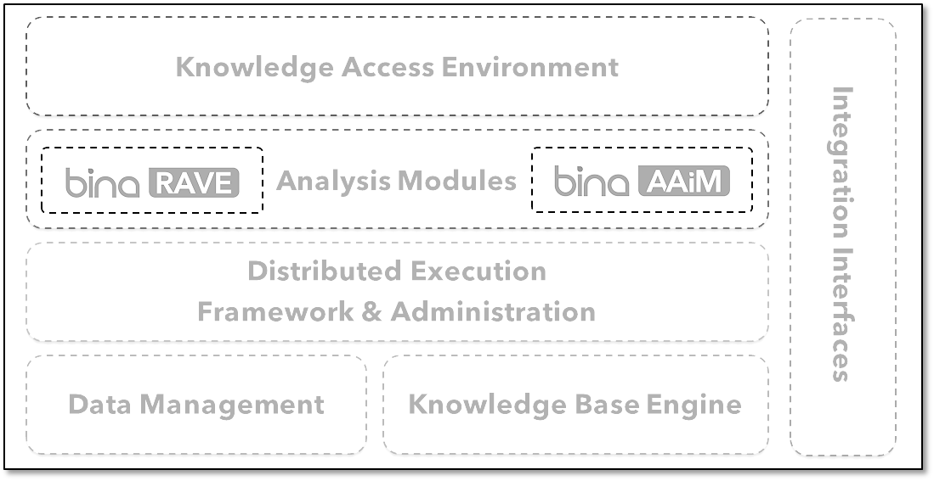











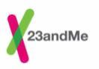





Innovation Through Multi-Disciplinary Expertise
The Bina Team: Over 100 Years of Experience & Skill
Big Data
Genomics
Software Engineering
Data Analytics
Bioinformatics
Statistics
Support
Training
Integration
Customization

Slide 6
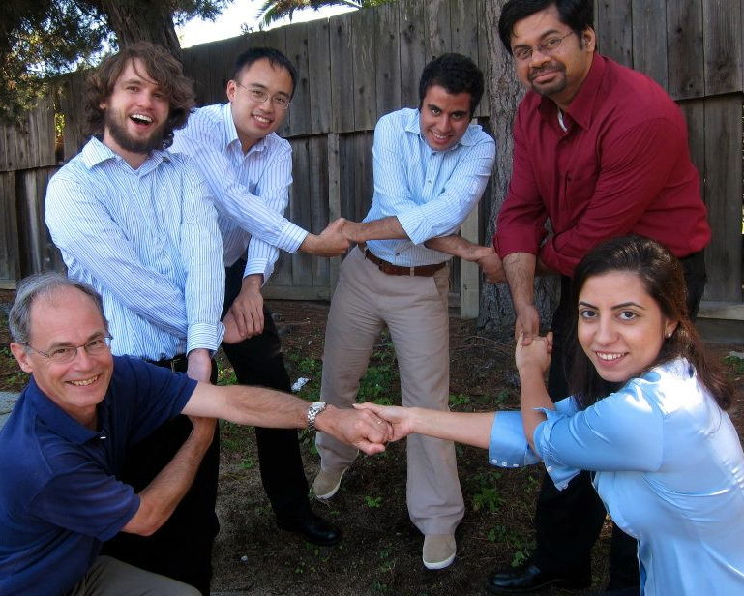

Bina : From Idea to Enterprise!
August 2011.
Left Stanford to Start Bina.
August 2015.
Bina part of Roche Sequencing!

Slide 7
Bina’s Product and Technology

Slide 8



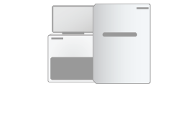
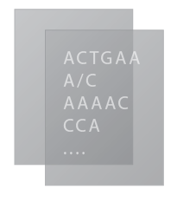


Bina Genomic Management Solution
Sequencing
2º Analysis
3º Analysis
Interpretation
Raw Data
Analysis Modules
An open & comprehensive suite of NGS analytical tools for Whole-Genome, Whole-Exome, RNA-Seq, targeted panels, and somatic mutations.
Notes:
At bina, we focus on the analysis of next generation sequencing datasets and provide best in class tools for secondary and tertiary analysis of Whole Genome, Whole Exome, RNAseq and targeted panel data sets. By optimizing the workflows, and tools incorporated in those workflows, to function as efficiently as possible on hardware we supply, we can achieve speed and performance unparalleled in the industry. I will spend the majority of this presentation discussing our analytical workflows, the methods we use to benchmark the tools and workflows, and the performance of those tools running our appliances.

Slide 9


Analysis Modules

Slide 10
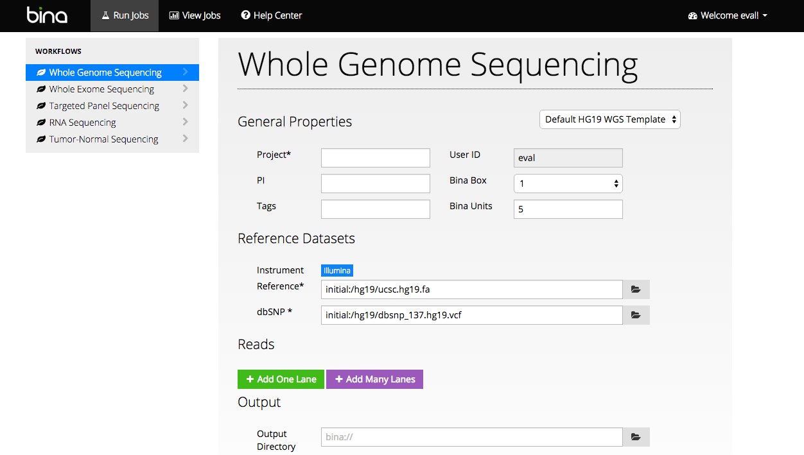
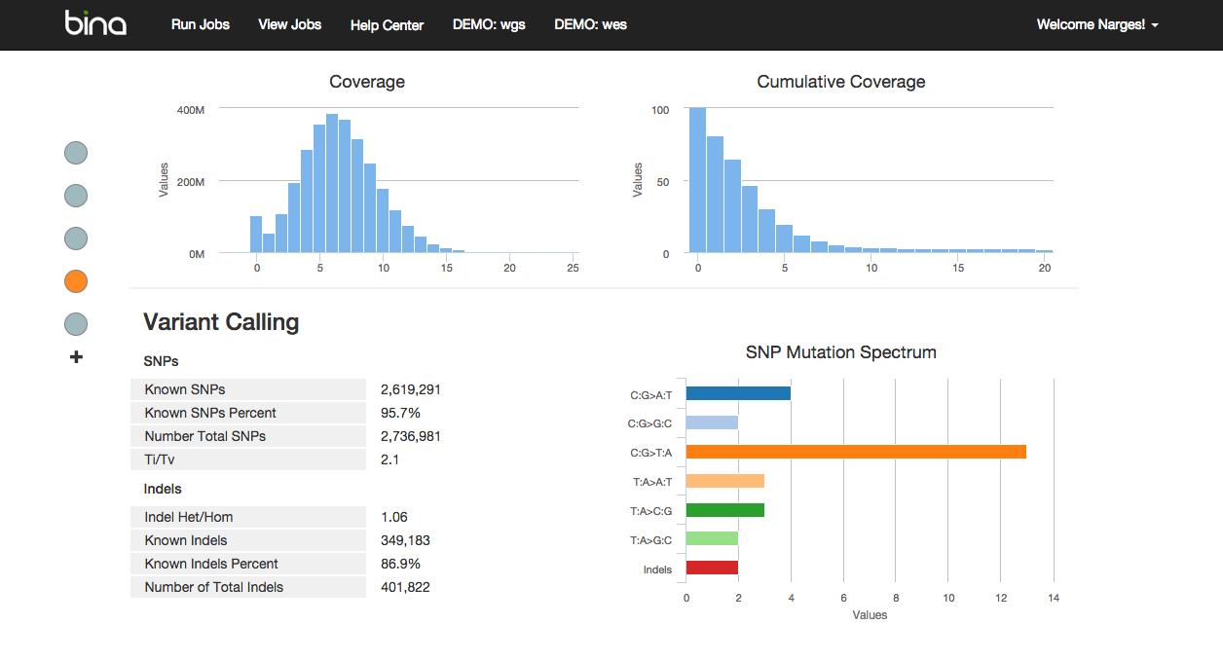

Read, Alignments, Variant, Expression
Interactive UI // Command Line SDK
Secure REST Interface
Portal Server(s)
Workflow Definition
Templates
QC/Monitoring
System Management/Updates
Secure Push
Interface
Executor Nodes / VMs
Portal Backend
(Distributed)
Executor
Dynamic
Scheduling
Workflows
Static
Scheduling
Distributed
Workflow
Orchestration
Tools
Execution Engine
Workflow Generation
Local Storage
Commands
Task Dependency
Graphs
Network Storage – Input/Output Data
For Research Use Only. Not for use in diagnostic procedures.
Notes:
For customers with very large amount of data and compute demand or very sensitive data. In countries with no access to secure public clouds

Slide 11




Annotation, Analytics, Intelligence Module
Annotation and Indexing Engine
Analytics Engine
Proband
Tumor/Normal
Pedigree
Cohort Study
Queries, Filters, Variant Sets, Reports
Input
VCF
UI/CMD
Distributed Execution
Framework
Annotation
(Join static DBs)
Indexing &
Functional Filters
Bina
Secondary
NoSQL
Data Store
Metadata
Store
MapReduce Jobs
Genomic
Context
Clinical
Annotations
Prediction
Func. Impact
Population
Frequency
Indices
Notes:
For customers with very large amount of data and compute demand or very sensitive data. In countries with no access to secure public clouds

Slide 12

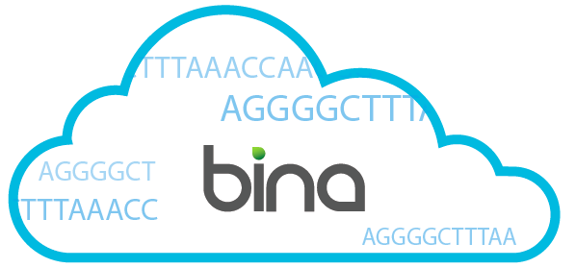
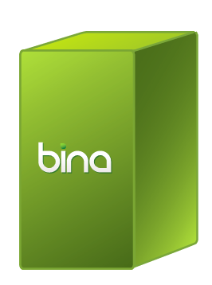

Deployment Options
Scale out architecture
High Performance Computing Best Practices
Bina Desktop
Bina Rack
On premises
Private Cloud

Slide 13

AWS Deployment Topology
All instances deployed on private subnet
Single gateway (NAT) on public subnet
SSL
Gateway for install / upgrades
VPC
m1.medium
Job/cluster/
Saltstack manager
REST / UI server,
m1.large
m1.large
Metadata/user DB
t1.medium RDS
AWS services
5 x m1.xlarge
m1.large
AWS SES (email service)
5 x m1.xlarge
S3 (Backup, HDFS-Future)
3 x m1.xlarge
Route 53 (DNS)
LUKS Encryption
5 x m1.xlarge
Cloud watch
LUKS Encryption
HDFS (local instance)
HDFS (local instance)

Slide 14
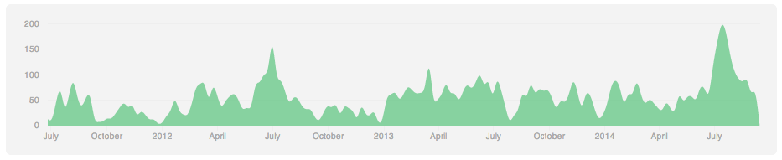
Learn how to develop professional software
Tools
Processes
Source Control (GitHub)
Build systems (Maven, SCons, Ant, Internal Build System)
Test Automation (TestNG, Karma, …)
Continues integration (Jenkins, Bamboo)
Quality Assurance
Agile Development (Green Hopper)
Code Reviews (GitHub)
Issue, Customer Request, Product Management Tracking (JIRA)
Design and documentation (Wiki, Google Docs)
Release Management (Internal)
Beta Releases, Pilot programs, …
Unit | Workflow | Integration | Release
1000s | 100+ | 50+ | 100+
Overall test suite counts, run regularly
3-Year GitHub commit history.

